Slide 1

Course Name: Hardware Security
Faculty Name: Prof Debdeep Mukhopadhyay
Department : Computer Science and Engineering
Topic
Lecture 27: Power Analysis-III

Slide 2

Concepts Covered:
DPA Set Up
Power Models
Noise in Power Traces
Statistical Analysis of Power Traces
Statistical Analysis of DoM

Slide 3
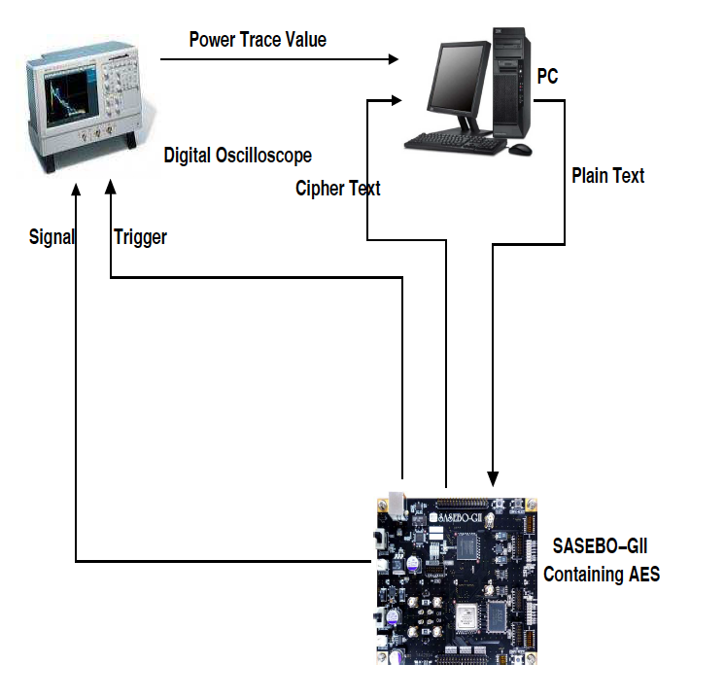
Power Attack Setup and Power Traces
Design-Under-Test (DUT): Target platform on which the encryption runs. Our board is called SASEBO board.
There are 2 FPGAs:
Control FPGA: Contains codes for communication with CPU. Acts as a controller, which provides inputs and required control signals to the second FPGA which hosts the crypto-algorithm. Communication with the CPU is done through a USB cable.
Oscilloscope: The oscilloscope is used for acquiring power traces. Upon receiving trigger signal, power traces are obtained and sent to the CPU. Triggering, indicates start of the encryption and help us to identify the desired power traces. The oscilloscope should have high sampling rate.
CPU: The heart is the CPU. The whole setup along with the operation of other components are controlled by CPU. Interface between CPU and oscilloscope is to be developed.

Slide 4
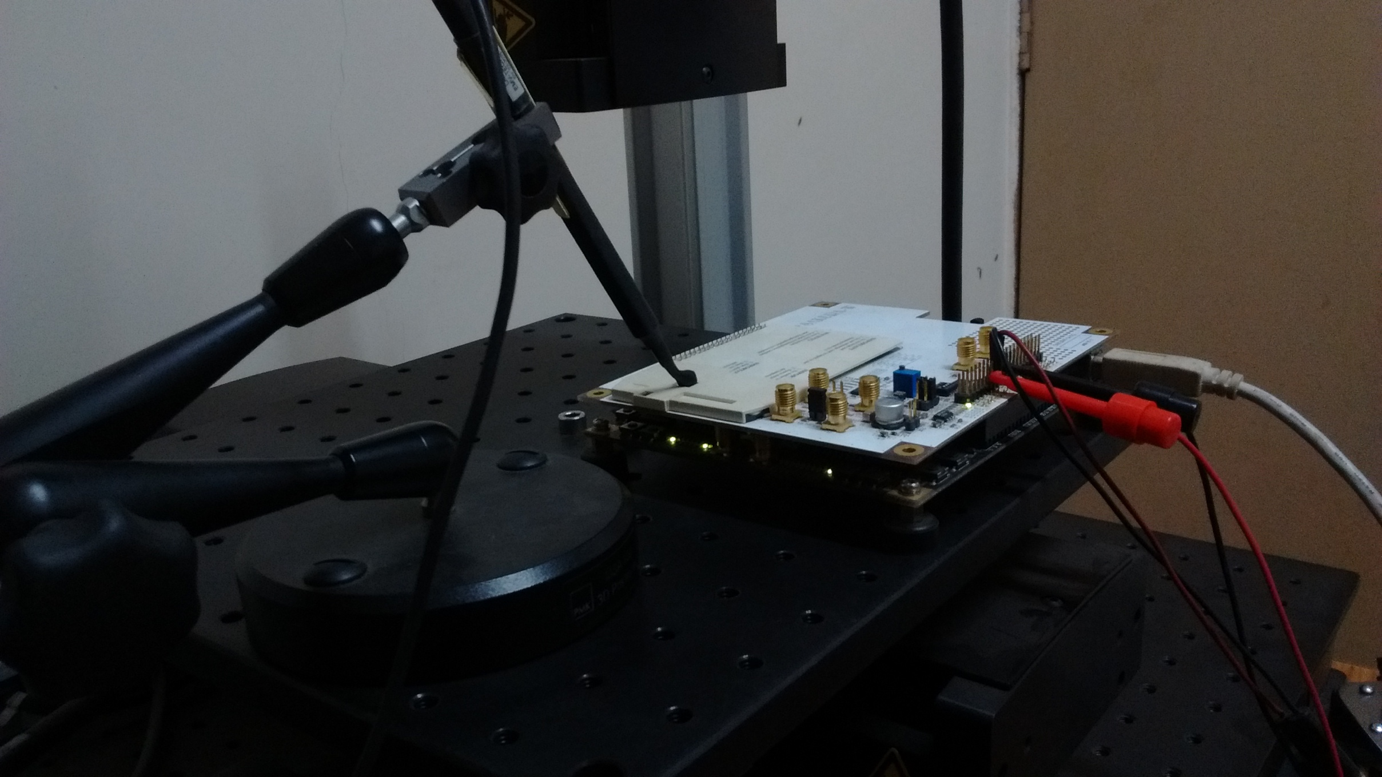

Power Capture
Crypto FPGA frequency : 2 MHz
Oscilloscope Sampling Frequency: 2.5 GS/s
Samples per cycle: 1250
Near Field Probes (H Field)
Operating Frequency: 30MHz to 3 GHz
Loop headed probes are generally used for injection. Straight headed probes are generally used for power analysis.

Slide 5
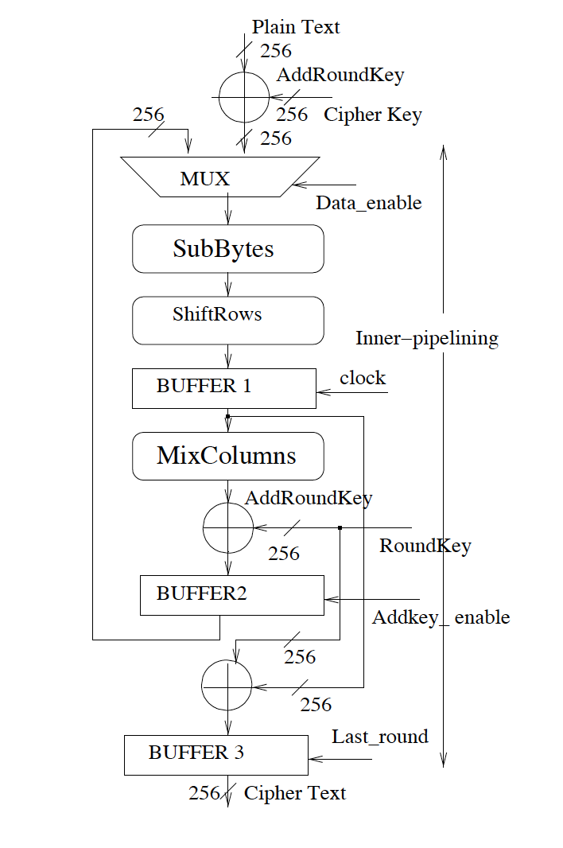
The Design Under Test
Rolled AES architecture
AES-128, though can be extended to any parameter.
AES-128 implemented on Virtex-5 FPGA (xc5vlx50), has a trigger signal which aligns the power traces, so that each trace profile corresponds to the same sequence of operations in an encryption run.
The signal is tapped from the controller pin of the FPGA board and is fed to the second channel of the oscilloscope.
The plaintext input is fed from the PC and the ciphertext is fed back to the PC for correctness check.
The power trace from the board is acquired by the oscilloscope and the power trace values are stored in the PC.

Slide 6
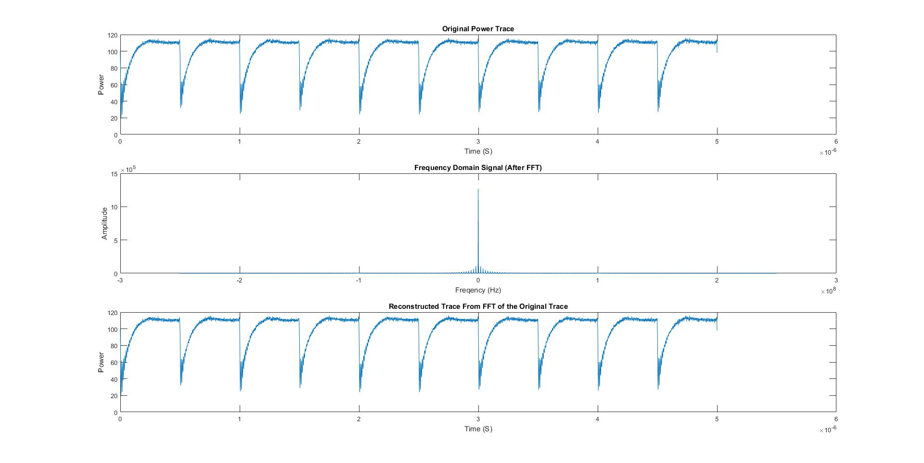
Power Trace and FFT
Crypto FPGA frequency : 2 MHz
Oscilloscope Sampling Frequency: 2.5 GS/s
Samples per cycle: 1250
Max Frequency without aliasing: 1.25 GHz (The frequency range has been truncated in plot to zoom in the plot)
This is a two-sided frequency domain plot.

Slide 7
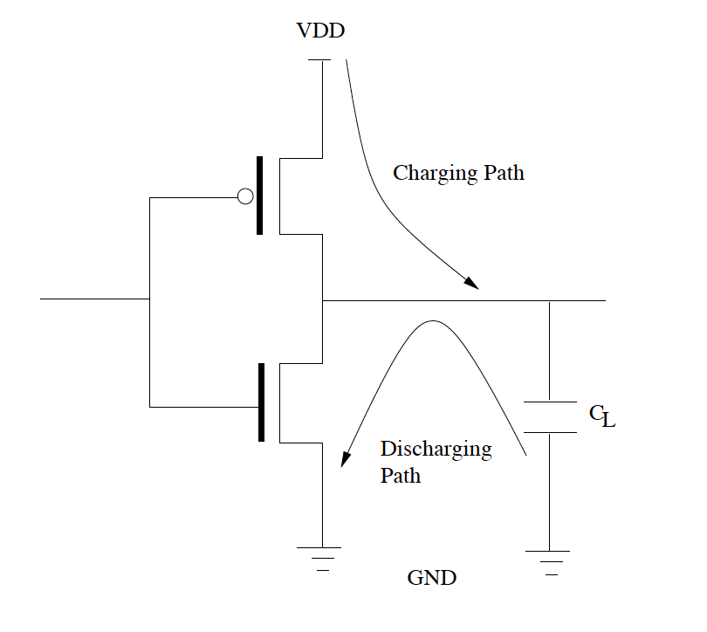
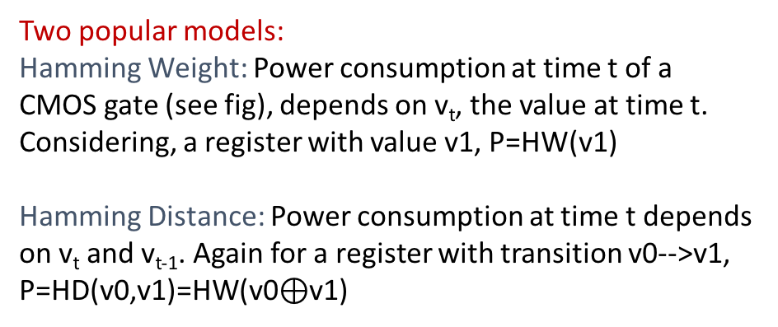
Power Models
Power analysis depends largely on power simulation, which predicts the power variation of a device wrt. the change of internal values.
The internal value is often computed from the ciphertext and the assumed portion of the key, and the power model which maps the internal value to a power level.
More than the actual value, relative predictions are most important.
v_{t}
Two popular models:
Hamming Weight: Power consumption at time t of a CMOS gate (see fig), depends on v_{t}, the value at time t. Considering, a register with value v1, P=HW(v1)
Hamming Distance: Power consumption at time t depends on v_{t} and v_{t-1}. Again for a register with transition v0-->v1, P=HD(v0,v1)=HW(v0$⊕$v1)

Slide 8
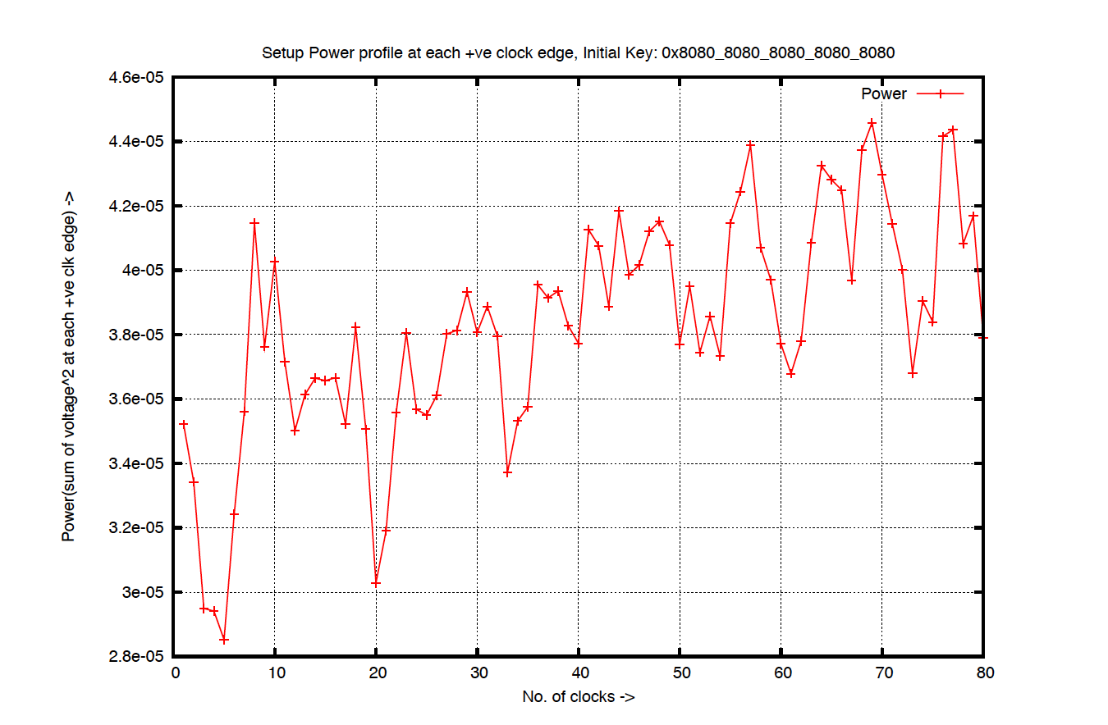
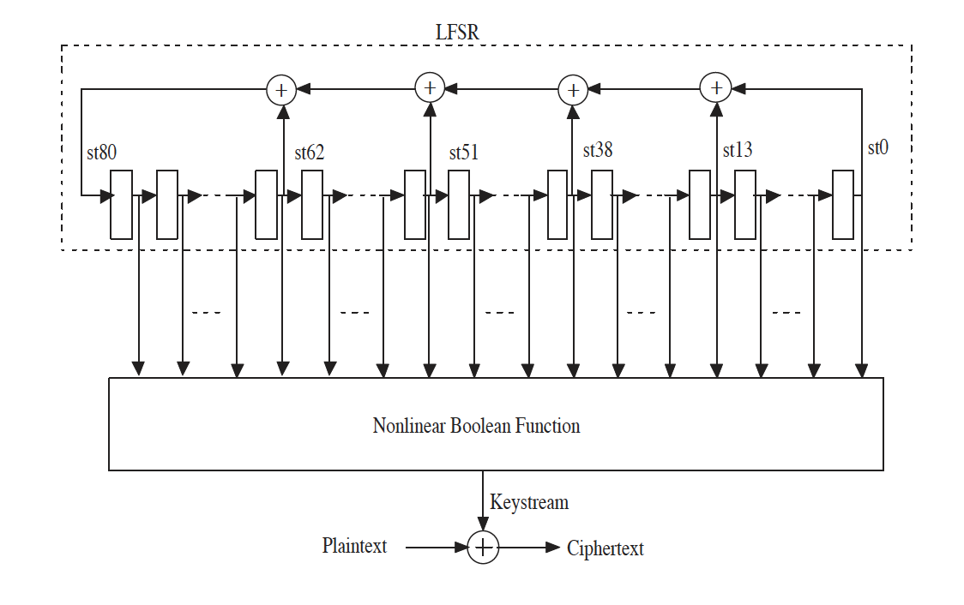
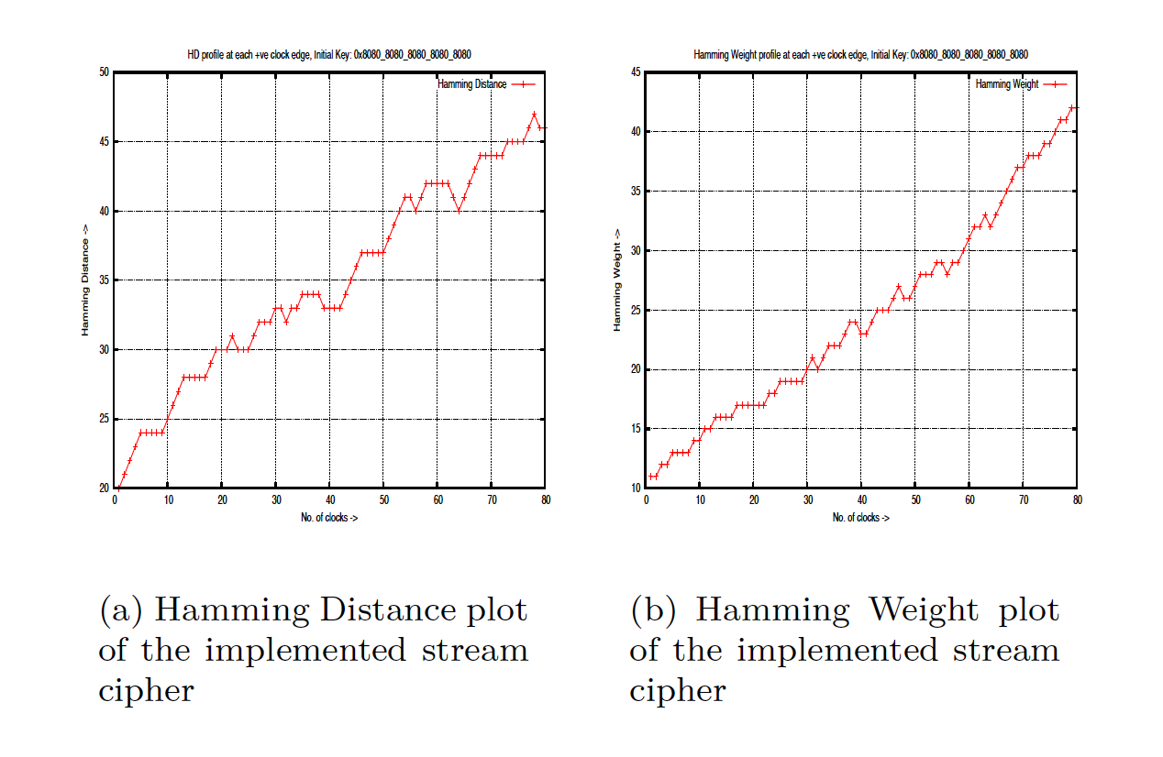
An Example Model
Actual power traces taken as voltage drop. The
power traces for 80 consecutive clock cycles after de-asserting reset
Power Simulation using Hamming Weight and Hamming Distance Models
A Linear Feedback Shift Register (LFSR), and a nonlinear function
is implemented on Xilinx
FPGA platform XC3S400-5PQ208 device

Slide 9
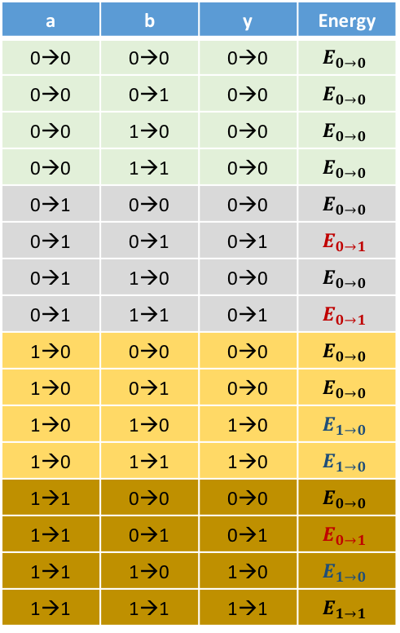
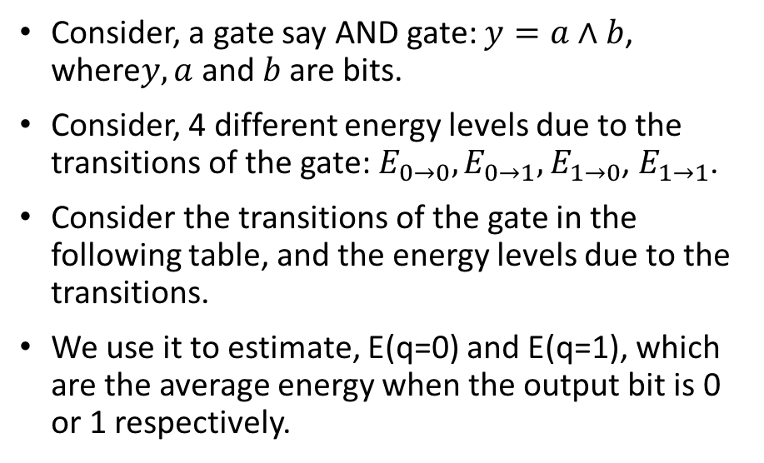
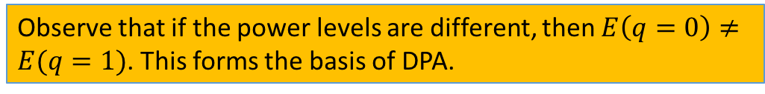
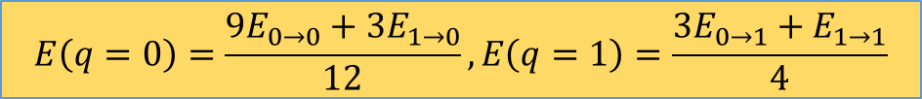
Why do Gates Leak?
a | b | y | Energy
0→0 | 0→0 | 0→0 | $$E_{0→0}$$
0→0 | 0→1 | 0→0 | $$E_{0→0}$$
0→0 | 1→0 | 0→0 | $$E_{0→0}$$
0→0 | 1→1 | 0→0 | $$E_{0→0}$$
0→1 | 0→0 | 0→0 | $$E_{0→0}$$
0→1 | 0→1 | 0→1 | $$E_{0→1}$$
0→1 | 1→0 | 0→0 | $$E_{0→0}$$
0→1 | 1→1 | 0→1 | $$E_{0→1}$$
1→0 | 0→0 | 0→0 | $$E_{0→0}$$
1→0 | 0→1 | 0→0 | $$E_{0→0}$$
1→0 | 1→0 | 1→0 | $$E_{1→0}$$
1→0 | 1→1 | 1→0 | $$E_{1→0}$$
1→1 | 0→0 | 0→0 | $$E_{0→0}$$
1→1 | 0→1 | 0→1 | $$E_{0→1}$$
1→1 | 1→0 | 1→0 | $$E_{1→0}$$
1→1 | 1→1 | 1→1 | $$E_{1→1}$$
Consider, a gate say AND gate: $y=a∧b$, where$y, a$ and $b$ are bits.
Consider, 4 different energy levels due to the transitions of the gate: $E_{0→0}, E_{0→1},$ $E_{1→0}$, $E_{1→1}$.
Consider the transitions of the gate in the following table, and the energy levels due to the transitions.
We use it to estimate, E(q=0) and E(q=1), which are the average energy when the output bit is 0 or 1 respectively.
$$E\left(q=0\right)=\frac{9E_{0→0}+3E_{1→0}}{12}, E\left(q=1\right)=\frac{3E_{0→1}+E_{1→1}}{4}$$
Observe that if the power levels are different, then $E\left(q=0\right)≠E(q=1)$. This forms the basis of DPA.

Slide 10
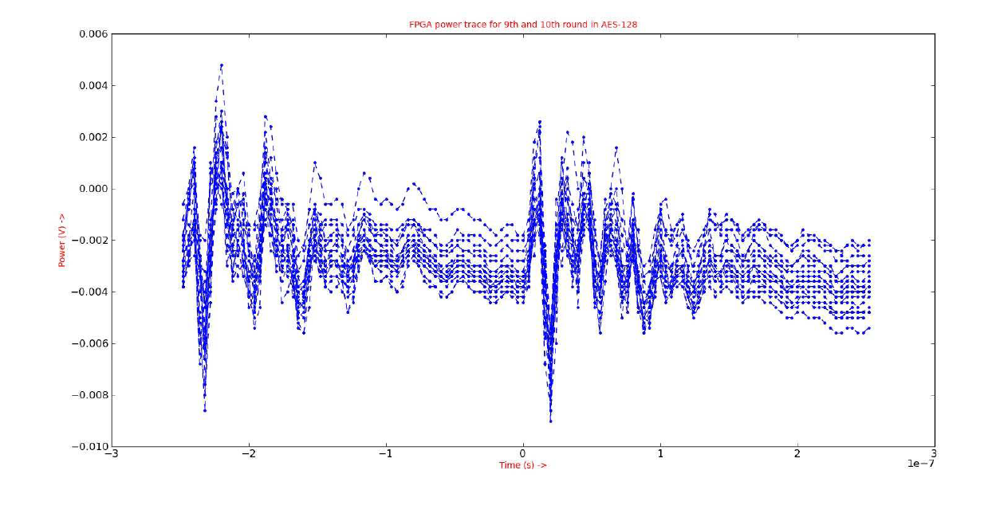
Quality of Measurement and Noise
High quality of power traces captured is central to the accuracy of DPA.
AES-128 Encryption with same plaintext and key, but resulting in different power traces.
These fluctuations are due to electrical noise, caused by noise due to power supply, clock generator, conduction and radiation emissions from the components connected to the device under attack.

Slide 11
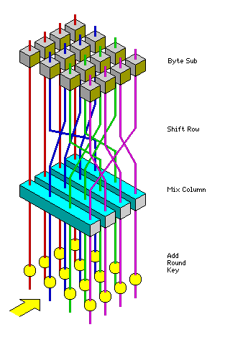
Algorithmic Noise
Algorithmic
Noise
Algorithmic or switching noise occurs because of contributions of logic cells to the power consumption, which are not under attack.
The power trace corresponds to the total power consumption of the circuit.
However, in the attack we target only a small part (see red circle in fig.) to reveal a portion of the key.
The power consumption from all the other parts (see blue shaded portion in fig.) form the algorithmic noise.
This would be more in a parallel implementation, compared to a serialized implementation.
Signal
Component

Slide 12
Quality of Probes
Power consumption of CMOS based cryptographic devices is an analog high-frequency (HF) signal, which means the frequency component or bandwidth of the power signals are in GHz range.
Measurement of such signals is challenging as they are affected in propagation from the logic cells on device to the oscilloscope by factors like filtering, cross talk, thermal noise, etc.
The parasitics in the mentioned path limit the bandwidth: due to bypass capacitances located in the power supply grid of the FPGA, and the parasitic inductances due to the bonding wires on the IO pads.
Filter out the high bandwidth components
The probes of the oscilloscope should have a bandwidth of more than 1 GHz and less than 4pF of capacitive loading: with such settings we can get a high bandwidth path for the power trace to propagate without degradation.

Slide 13
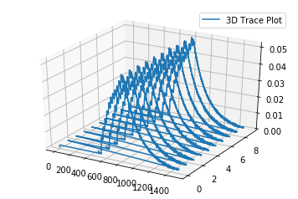
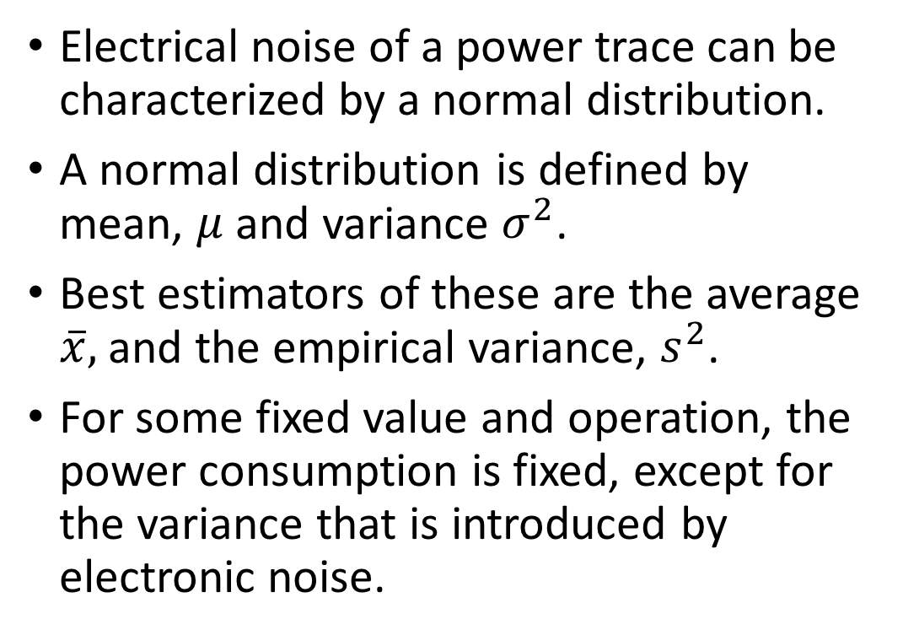
Statistical Analysis of Power Traces
Electrical noise of a power trace can be characterized by a normal distribution.
A normal distribution is defined by mean, $μ$ and variance $σ^{2}$.
Best estimators of these are the average $\overline{x},$ and the empirical variance, $s^{2}$.
For some fixed value and operation, the power consumption is fixed, except for the variance that is introduced by electronic noise.

Slide 14
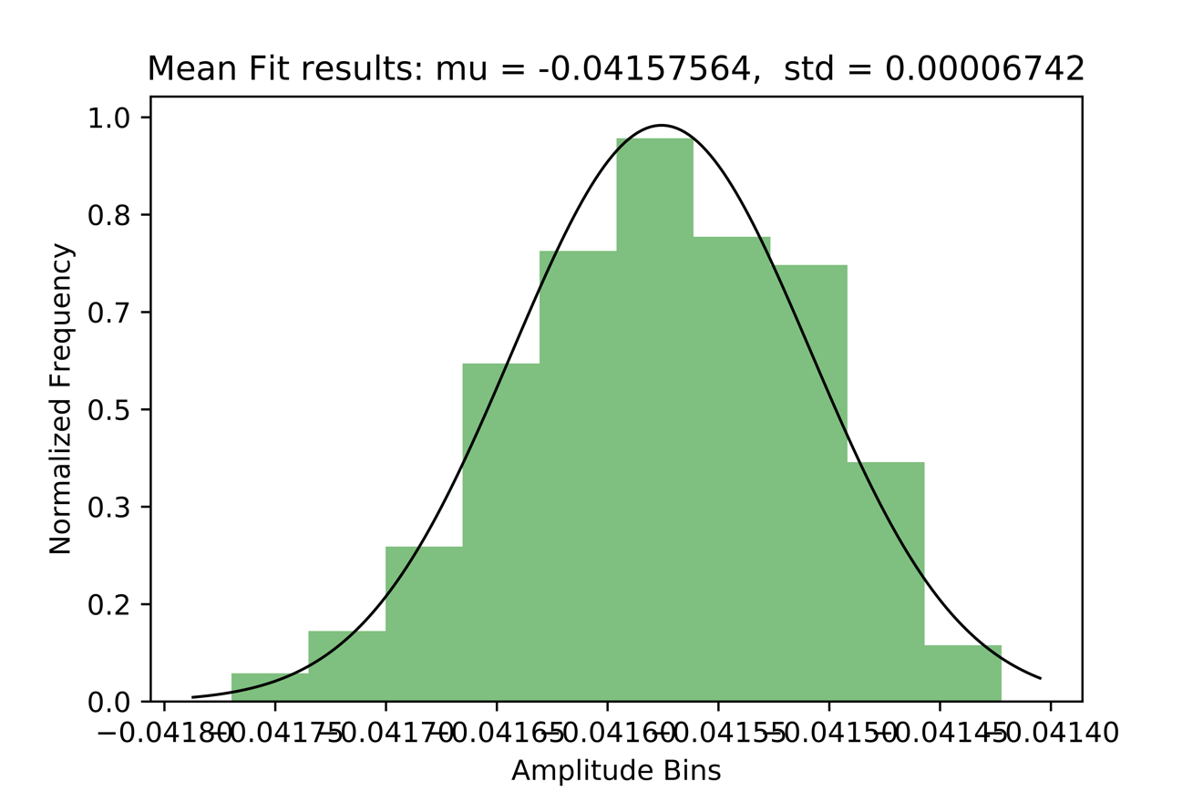
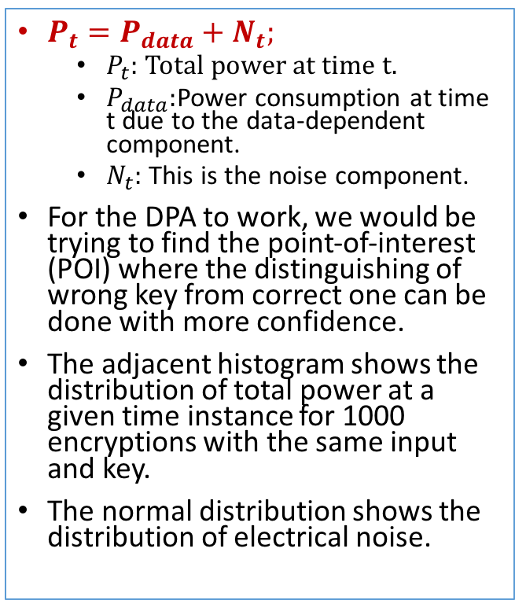
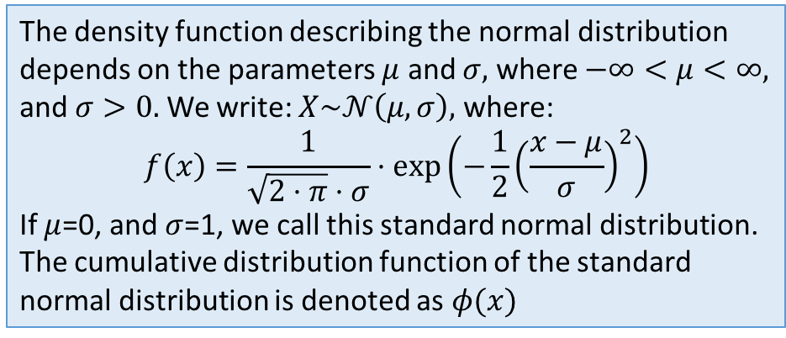
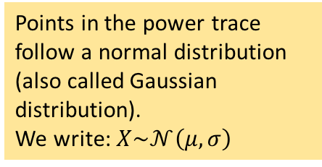
Components of Power Traces
$P_{t}=P_{data}+N_{t};$
$P_{t}:$Total power at time t.
$P_{data}:$Power consumption at time t due to the data-dependent component.
$N_{t}:$ This is the noise component.
For the DPA to work, we would be trying to find the point-of-interest (POI) where the distinguishing of wrong key from correct one can be done with more confidence.
The adjacent histogram shows the distribution of total power at a given time instance for 1000 encryptions with the same input and key.
The normal distribution shows the distribution of electrical noise.
Points in the power trace follow a normal distribution (also called Gaussian distribution).
We write: $X\sim 𝒩\left(μ,σ\right)$
The density function describing the normal distribution depends on the parameters $μ$ and $σ,$ where $−∞<μ<∞,$ and $σ>0.$ We write: $X\sim 𝒩\left(μ,σ\right),$ where:
$$f\left(x\right)=\frac{1}{\sqrt{2⋅π}⋅σ}⋅exp⁡\left(−\frac{1}{2}{\left(\frac{x−μ}{σ}\right)}^{2}\right)$$
If $μ$=0, and $σ$=1, we call this standard normal distribution.
The cumulative distribution function of the standard normal distribution is denoted as $φ(x)$

Slide 15
Sampling Distribution
Average value and standard deviation would change slightly for every experiment.
We can view the average and the empirical standard deviations as random variables.
Thus, mean value and the empirical standard deviation can be characterized by a probability distribution as well.
This concept is called sampling distribution.
Sampling distribution determines how well a certain parameter can be estimated.

Slide 16
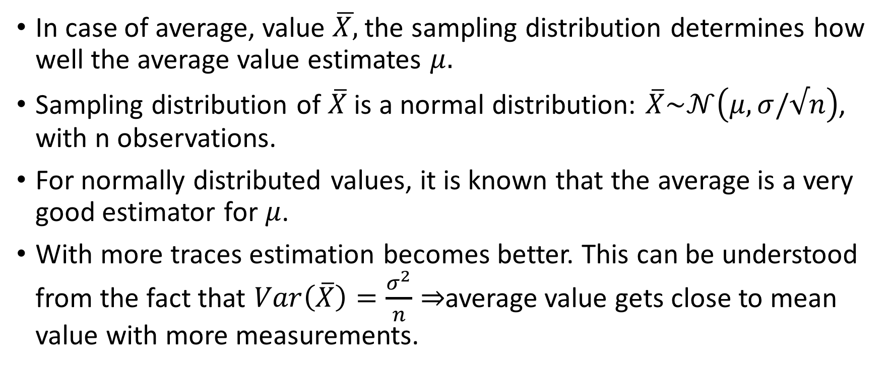
Sampling Distribution for Mean
In case of average, value $\overline{X,}$the sampling distribution determines how well the average value estimates $μ.$
Sampling distribution of $\overline{X}$ is a normal distribution: $\overline{X}\sim 𝒩\left(μ,σ/√n\right)$, with n observations.
For normally distributed values, it is known that the average is a very good estimator for $μ$.
With more traces estimation becomes better. This can be understood from the fact that $Var\left(\overline{X}\right)=\frac{σ^{2}}{n}⇒$average value gets close to mean value with more measurements.

Slide 17
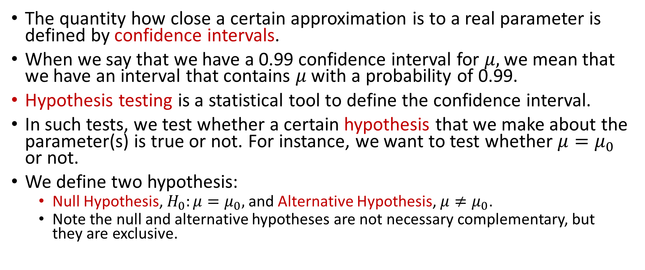
Confidence Intervals and Hypothesis Testing
The quantity how close a certain approximation is to a real parameter is defined by confidence intervals.
When we say that we have a 0.99 confidence interval for $μ,$we mean that we have an interval that contains $μ$ with a probability of 0.99.
Hypothesis testing is a statistical tool to define the confidence interval.
In such tests, we test whether a certain hypothesis that we make about the parameter(s) is true or not. For instance, we want to test whether $μ=μ_{0}$ or not.
We define two hypothesis:
Null Hypothesis, $H_{0}:μ=μ_{0},$and Alternative Hypothesis, $μ≠μ_{0}$.
Note the null and alternative hypotheses are not necessary complementary, but they are exclusive.

Slide 18
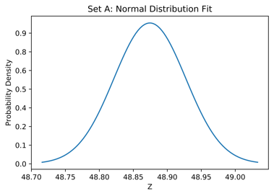
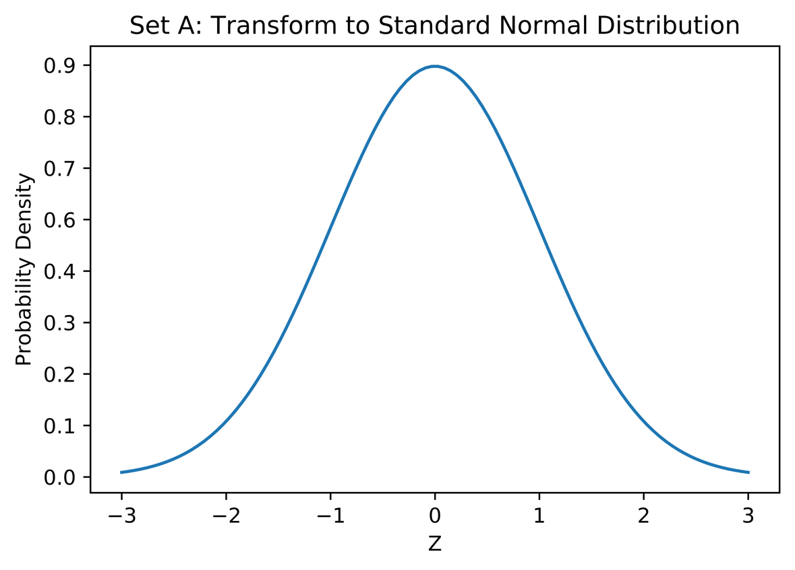

Transforming from Normal to Standard Normal Distribution
Say we have a sampling distribution for some mean: $\overline{X}\sim 𝒩\left(μ,σ/√n\right)$.
Then define $Z=\left(\overline{X}−μ\right)⋅\frac{√n}{σ}$ is a standard normal distribution.

Slide 19
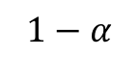
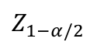
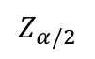
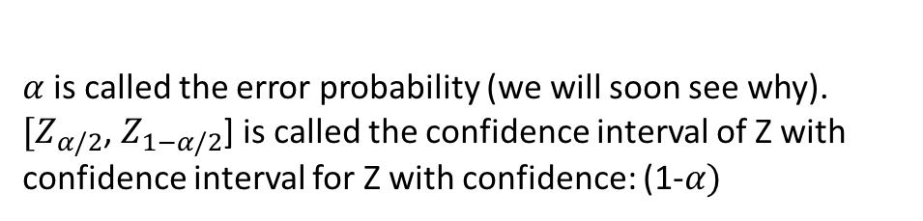
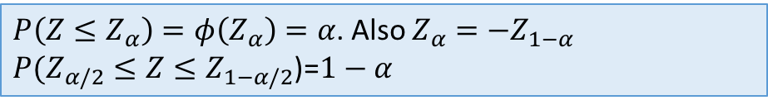
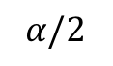

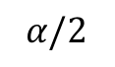
Characteristic of a Standard Normal Distribution
$P\left(Z≤Z_{α}\right)=φ\left(Z_{α}\right)=α$. Also $Z_{α}=−Z_{1−α}$
$P(Z_{α/2}≤Z≤Z_{1−α/2}$)=$1−α$
$$1−α$$
$α$is called the error probability (we will soon see why).
$[Z_{α/2}$, $Z_{1−α/2}$] is called the confidence interval of Z with confidence interval for Z with confidence: (1-$α)$
$$α/2$$
$$α/2$$
$$Z_{α/2}$$
$$Z_{1−α/2}$$
$$α$$ | 0.800 | 0.850 | 0.900 | 0.950 | 0.975 | 0.990 | 0.995 | 0.999 | 0.9999
$$z_{α}$$ | 0.842 | 1.036 | 1.282 | 1.645 | 1.960 | 2.326 | 2.576 | 3.090 | 3.7190
Quantiles $z_{α}$ of the $𝒩\left(0,1\right)$distribution for some values of $α$.

Slide 20
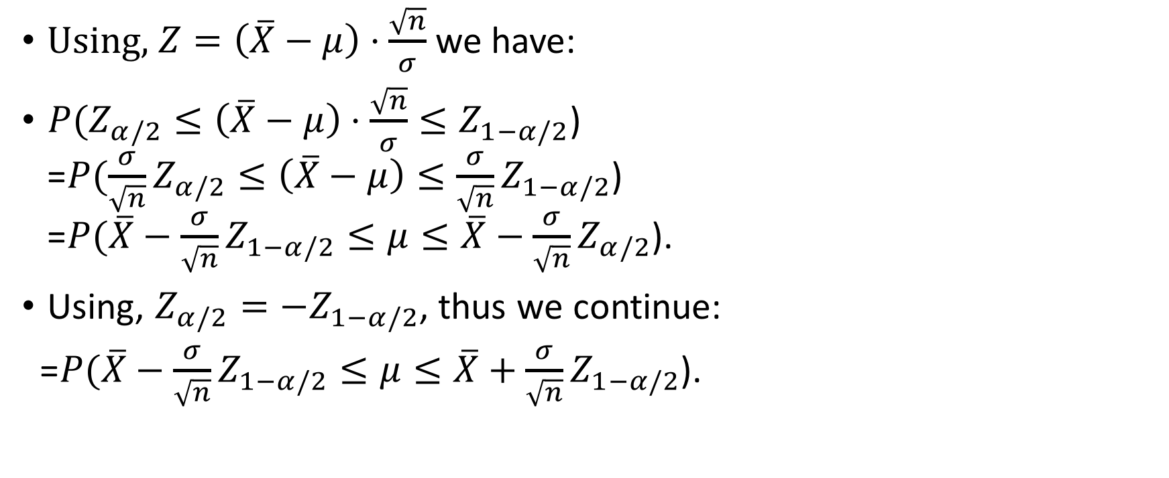

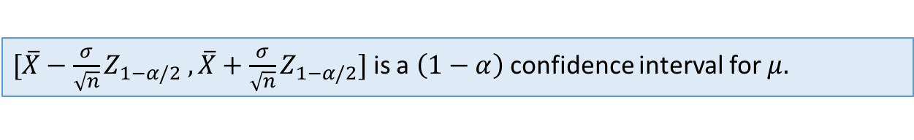
Derive the Confidence Interval for $μ$
Using, $Z=\left(\overline{X}−μ\right)⋅\frac{\sqrt{n}}{σ}$we have:
${P(Z}_{α/2}≤\left(\overline{X}−μ\right)⋅\frac{\sqrt{n}}{σ}≤Z_{1−α/2}$) =${P(\frac{σ}{\sqrt{n}}Z}_{α/2}≤\left(\overline{X}−μ\right)≤{\frac{σ}{\sqrt{n}}Z}_{1−α/2}$) =${P(\overline{X}−\frac{σ}{\sqrt{n}}Z}_{1−α/2}≤μ≤\overline{X}−\frac{σ}{\sqrt{n}}Z_{α/2}$).
Using, $Z_{α/2}=−Z_{1−α/2}$, thus we continue:
=${P(\overline{X}−\frac{σ}{\sqrt{n}}Z}_{1−α/2}≤μ≤\overline{X}+\frac{σ}{\sqrt{n}}Z_{1−α/2}$).
$[{\overline{X}−\frac{σ}{\sqrt{n}}Z}_{1−α/2} ,\overline{X}+\frac{σ}{\sqrt{n}}Z_{1−α/2}]$ is a $\left(1−α\right)$ confidence interval for $μ.$

Slide 21
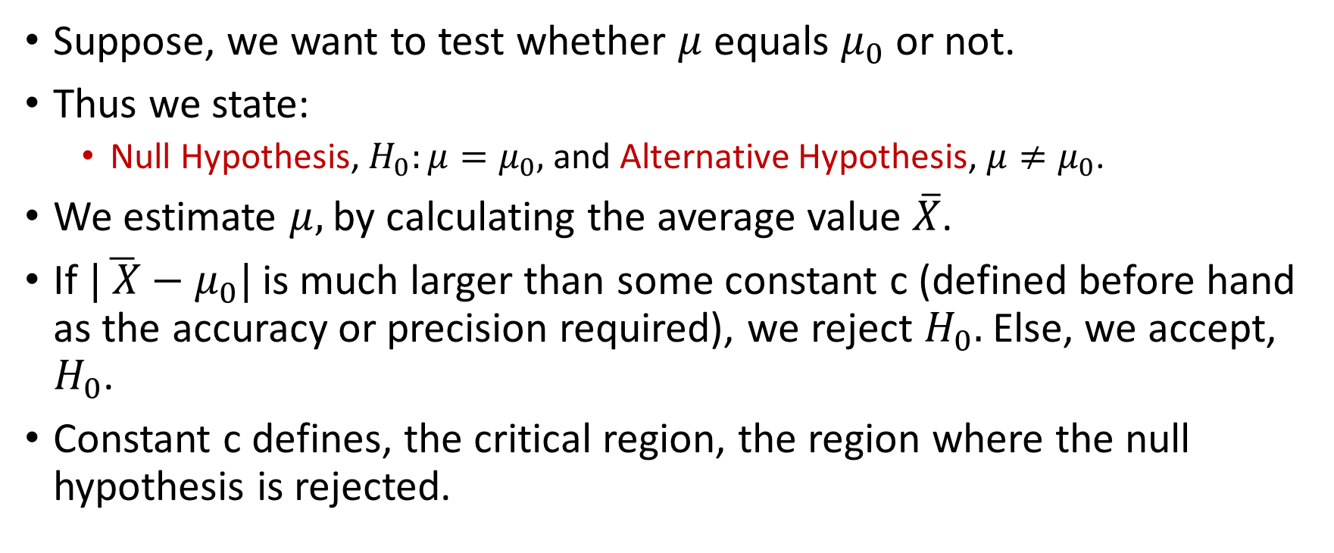
Hypothesis Test
Suppose, we want to test whether $μ$ equals $μ_{0}$ or not.
Thus we state:
Null Hypothesis, $H_{0}:μ=μ_{0},$and Alternative Hypothesis, $μ≠μ_{0}$.
We estimate $μ,$by calculating the average value $\overline{X}$.
If $|\overline{ X}−μ_{0}|$ is much larger than some constant c (defined before hand as the accuracy or precision required), we reject $H_{0}.$ Else, we accept, $H_{0}$.
Constant c defines, the critical region, the region where the null hypothesis is rejected.

Slide 22
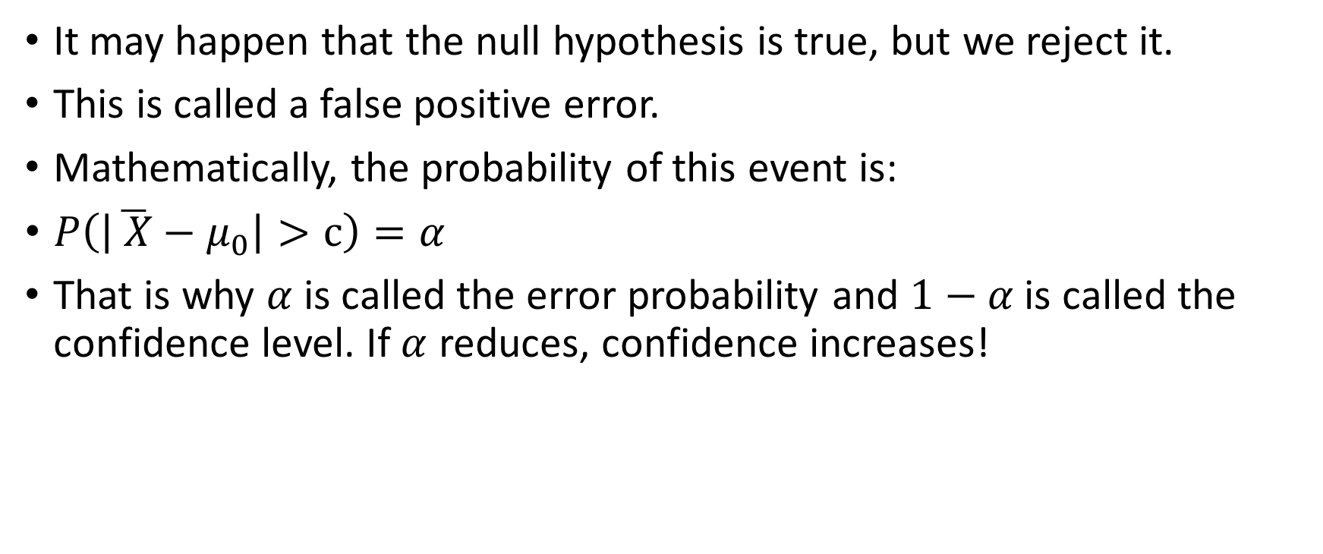
False Positive Error
It may happen that the null hypothesis is true, but we reject it.
This is called a false positive error.
Mathematically, the probability of this event is:
$P\left(\left|\overline{ X}−μ_{0}\right|>c\right)=α$
That is why $α$ is called the error probability and $1−α$ is called the confidence level. If $α$ reduces, confidence increases!

Slide 23
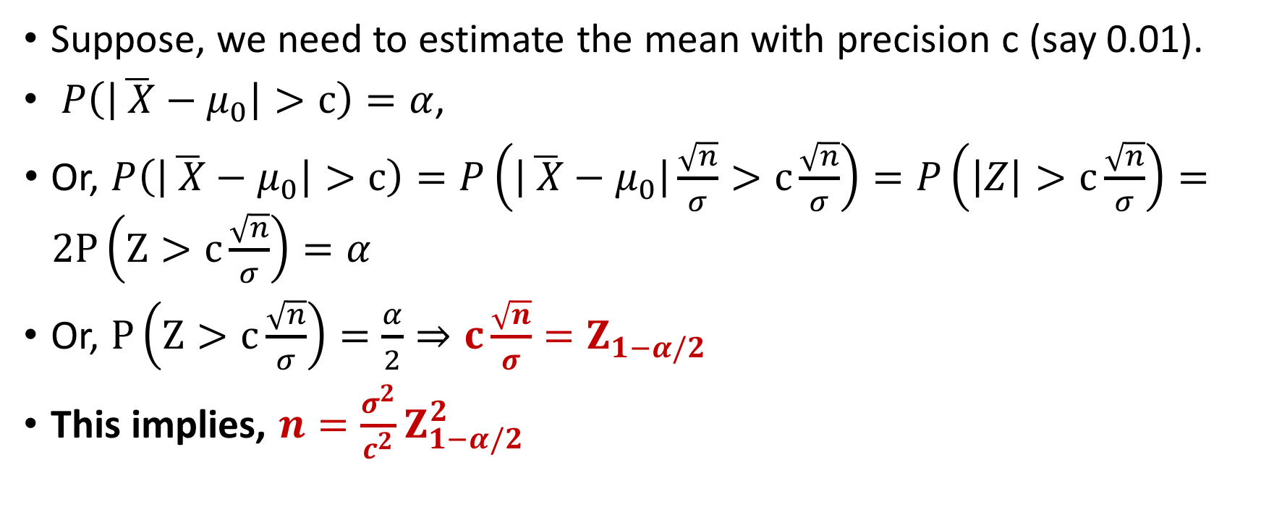

Estimating the Number of Traces to Estimate $μ$
Suppose, we need to estimate the mean with precision c (say 0.01).
$P\left(\left|\overline{ X}−μ_{0}\right|>c\right)=α$,
Or, $P\left(\left|\overline{ X}−μ_{0}\right|>c\right)=P\left(\left|\overline{ X}−μ_{0}\right|\frac{\sqrt{n}}{σ}>c\frac{\sqrt{n}}{σ}\right)=P\left(\left|Z\right|>c\frac{\sqrt{n}}{σ}\right)=2P\left(Z>c\frac{\sqrt{n}}{σ}\right)=α$
Or, $P\left(Z>c\frac{\sqrt{n}}{σ}\right)=\frac{α}{2}⇒c\frac{\sqrt{n}}{σ}=Z_{1−α/2}$
This implies, $n=\frac{σ^{2}}{c^{2}}Z_{1−α/2}^{2}$

Slide 24
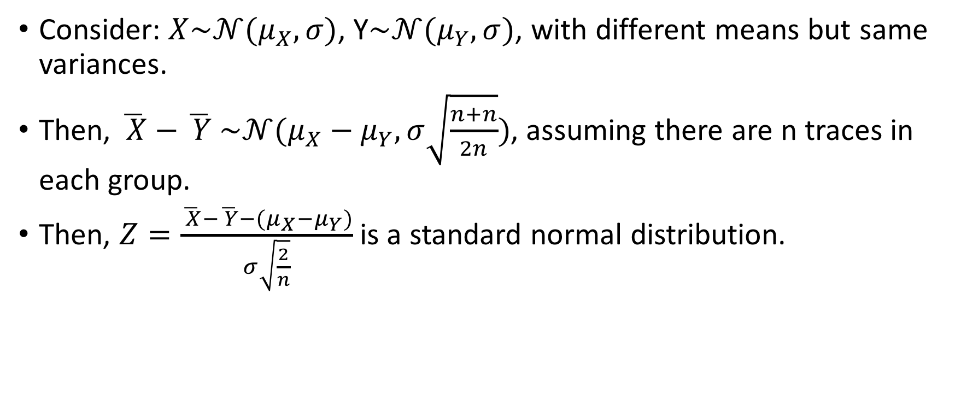
Estimating the number of traces for estimating DoM
Consider: $X\sim 𝒩(μ_{X},σ)$, Y$\sim 𝒩(μ_{Y},σ)$, with different means but same variances.
Then, $\overline{ X}−\overline{ Y}$ $\sim 𝒩(μ_{X}−μ_{Y},σ\sqrt{\frac{n+n}{2n}})$, assuming there are n traces in each group.
Then, $Z=\frac{\overline{ X}−\overline{ Y}−(μ_{X}−μ_{Y})}{σ\sqrt{\frac{2}{n}}}$ is a standard normal distribution.

Slide 25
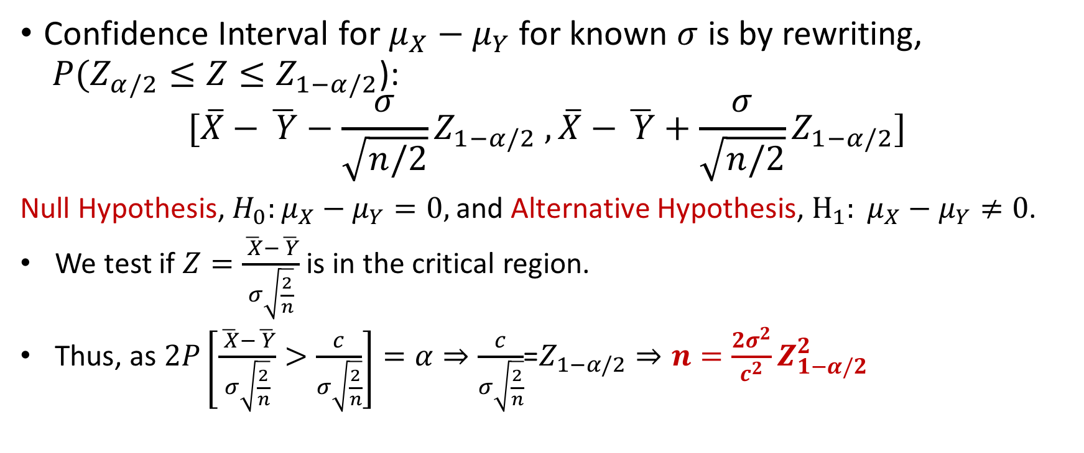
Confidence Interval for DoM
Confidence Interval for $μ_{X}−μ_{Y}$ for known $σ$ is by rewriting, $P(Z_{α/2}≤Z≤Z_{1−α/2}$):
$$[{\overline{X}−\overline{ Y}−\frac{σ}{\sqrt{n/2}}Z}_{1−α/2} ,\overline{X}−\overline{ Y}+\frac{σ}{\sqrt{n/2}}Z_{1−α/2}]$$
Null Hypothesis, $H_{0}:μ_{X}−μ_{Y}=0,$and Alternative Hypothesis, $H_{1}: μ_{X}−μ_{Y}≠0$.
We test if $Z=\frac{\overline{ X}−\overline{ Y}}{σ\sqrt{\frac{2}{n}}}$ is in the critical region.
Thus, as $2P\left[\frac{\overline{ X}−\overline{ Y}}{σ\sqrt{\frac{2}{n}}}>\frac{c}{σ\sqrt{\frac{2}{n}}}\right]=α⇒\frac{c}{σ\sqrt{\frac{2}{n}}}$=$Z_{1−α/2}⇒n=\frac{2σ^{2}}{c^{2}}Z_{1−α/2}^{2}$

Slide 26
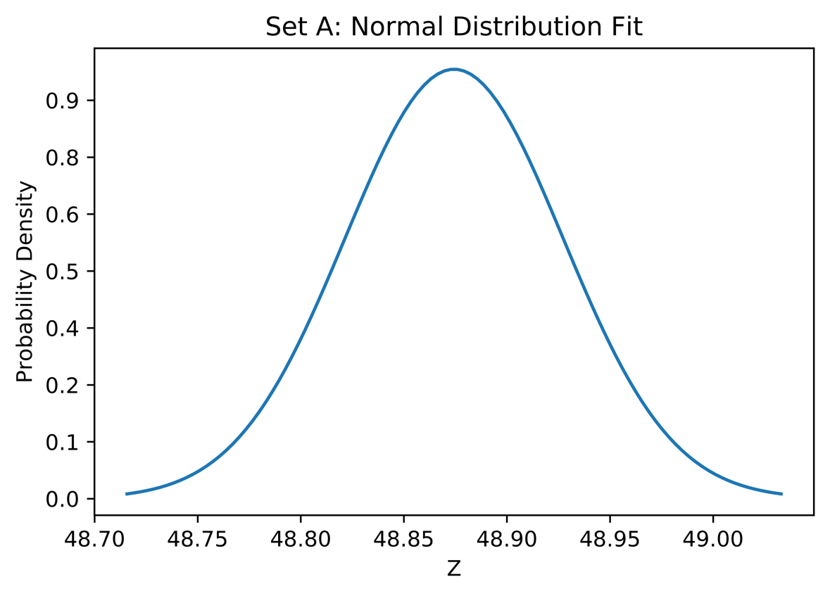
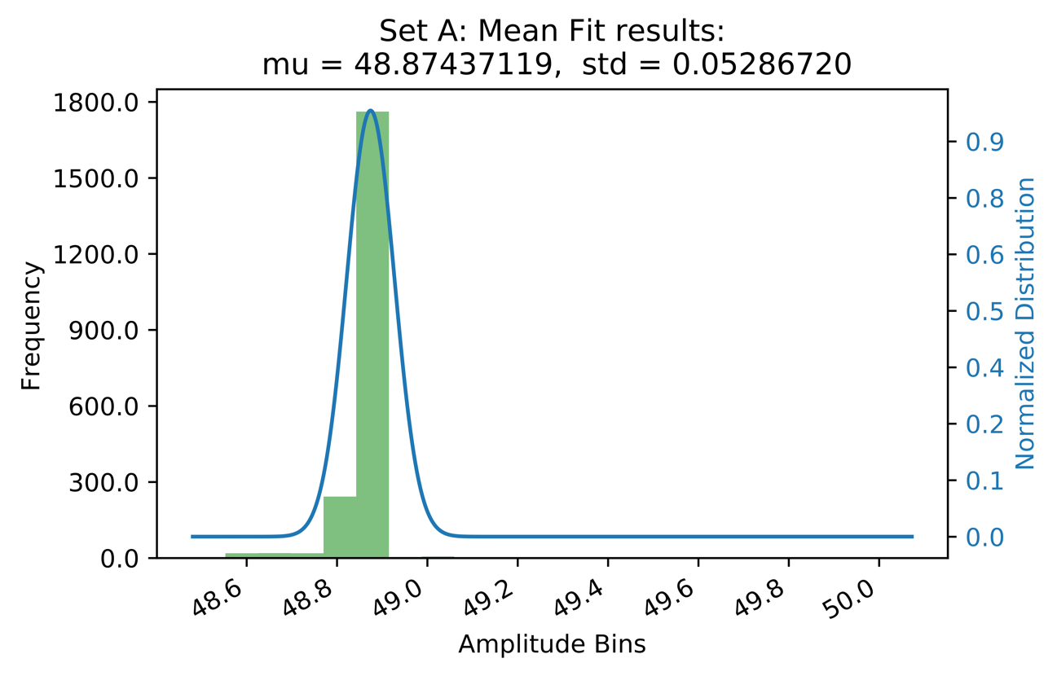
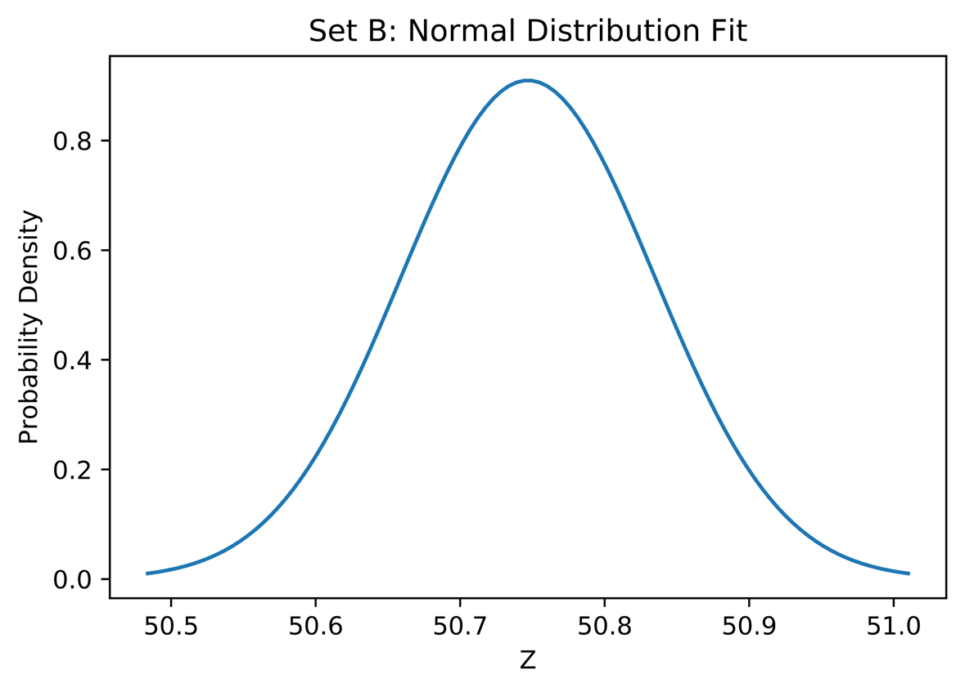
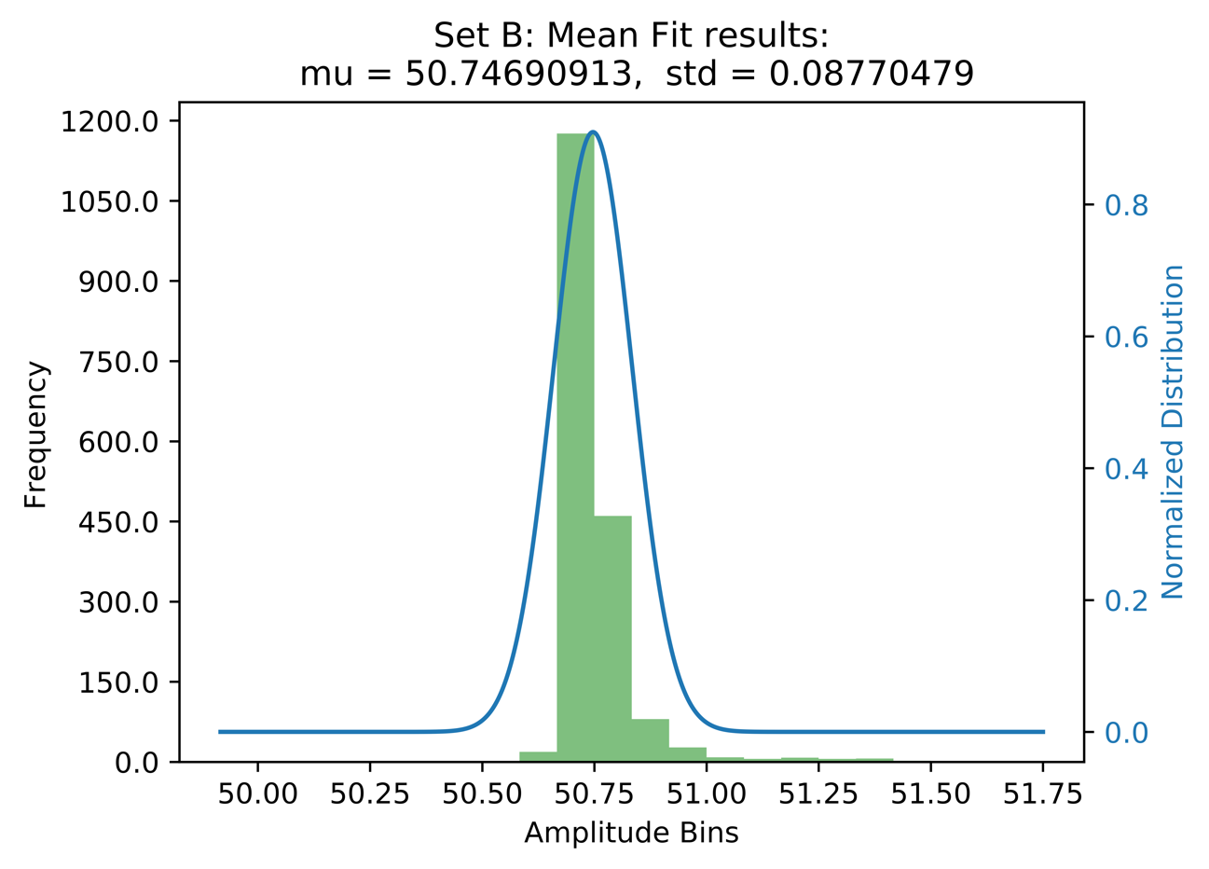
Applying all these to DoM DPA
Set A: refers to target bit 0
Set B: refers to target bit 1.
Sampling Distributions for mean power of the two sets.

Slide 27
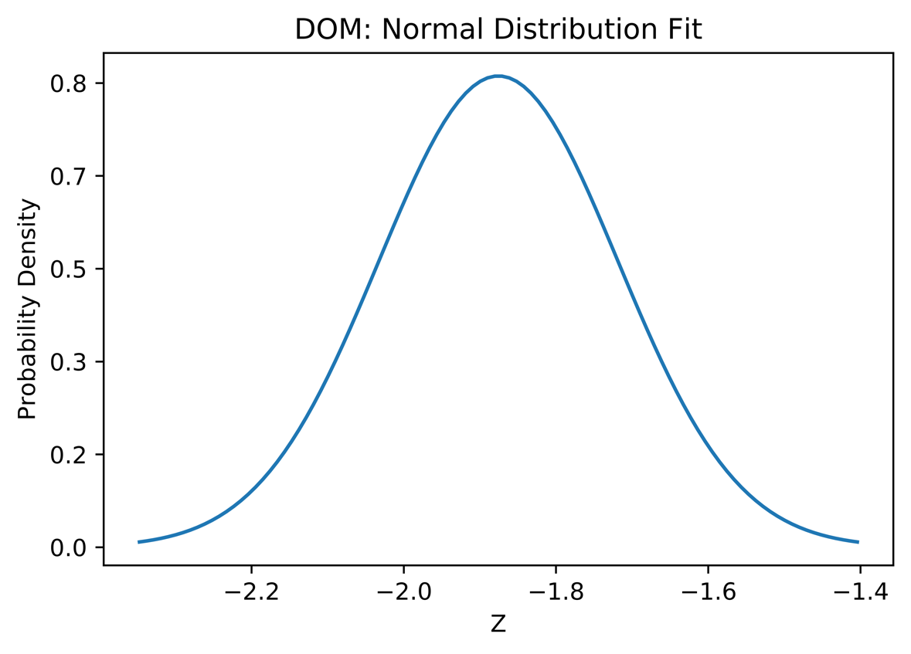
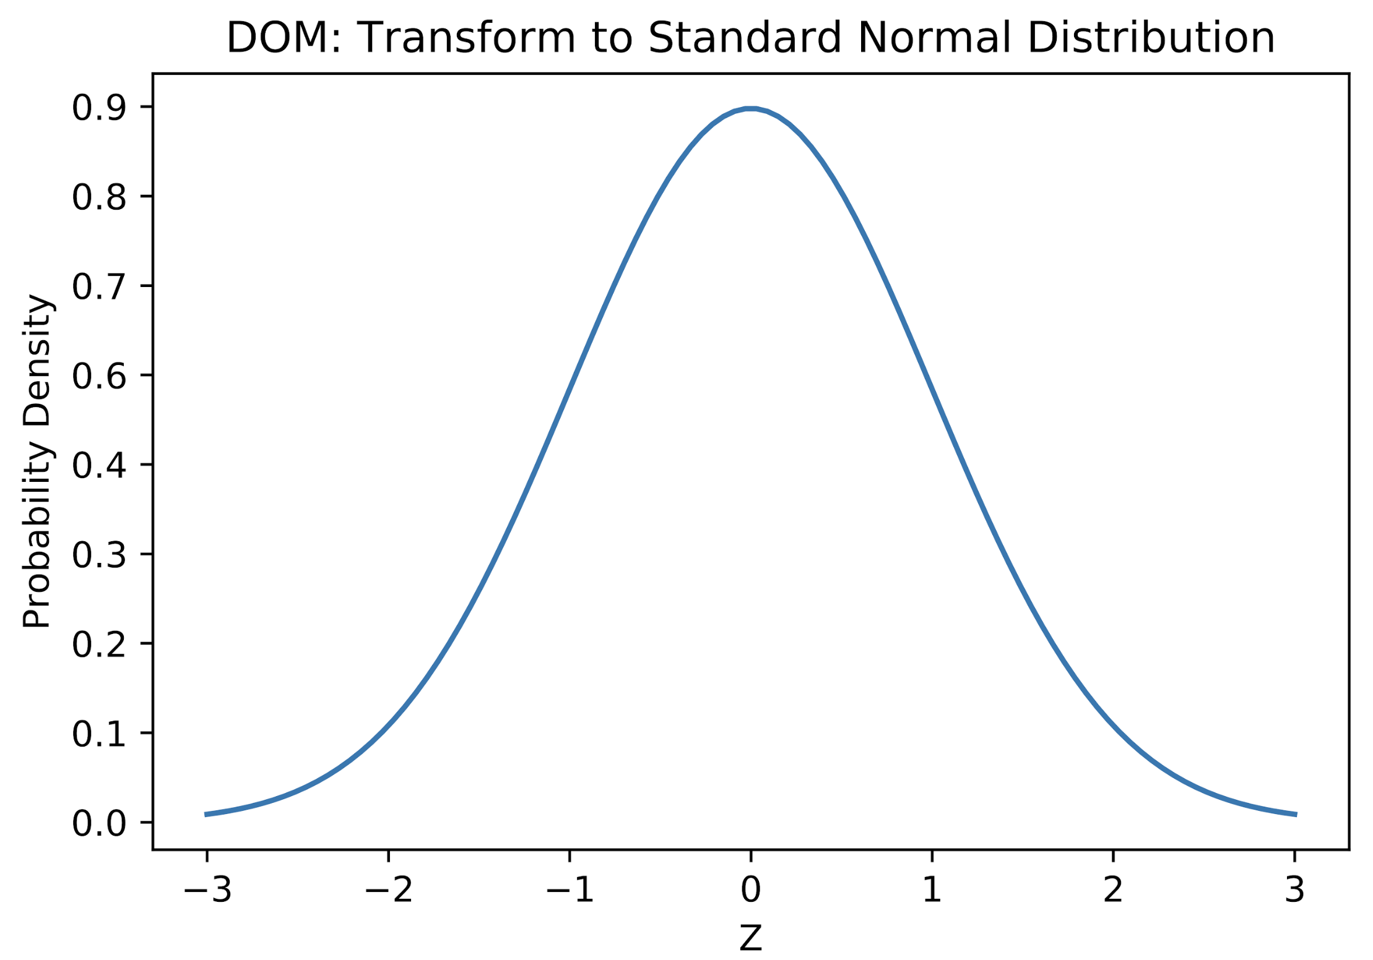
Normal and Standard Normal Curves for DoM
Standardize

Slide 28
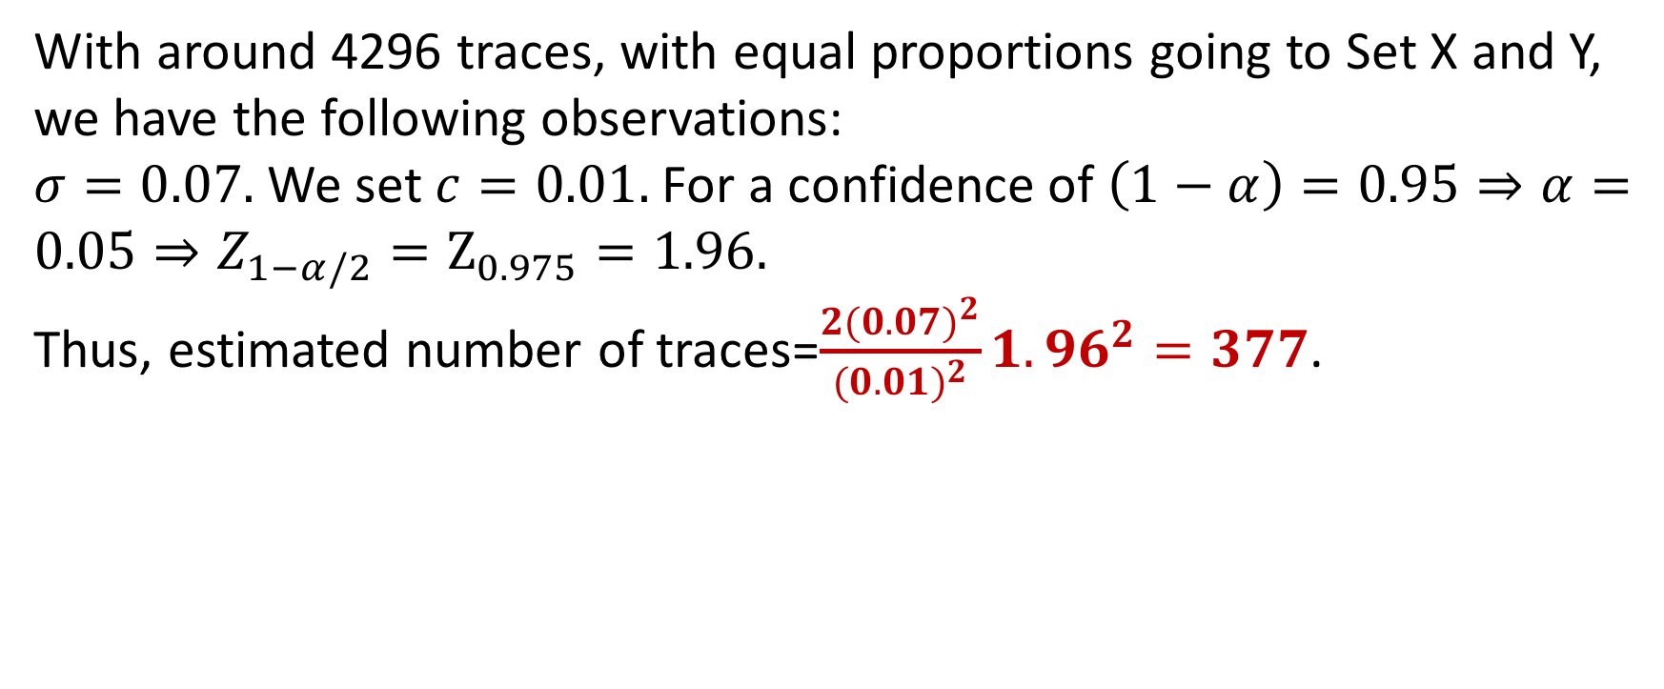
Estimating Number of Traces
With around 4296 traces, with equal proportions going to Set X and Y, we have the following observations:
$σ=0.07.$We set $c=0.01.$For a confidence of $\left(1−α\right)=0.95⇒α=0.05⇒Z_{1−α/2}=Z_{0.975}=1.96.$
Thus, estimated number of traces=$\frac{2{(0.07)}^{2}}{{(0.01)}^{2}}1.96^{2}=377$.

Slide 29
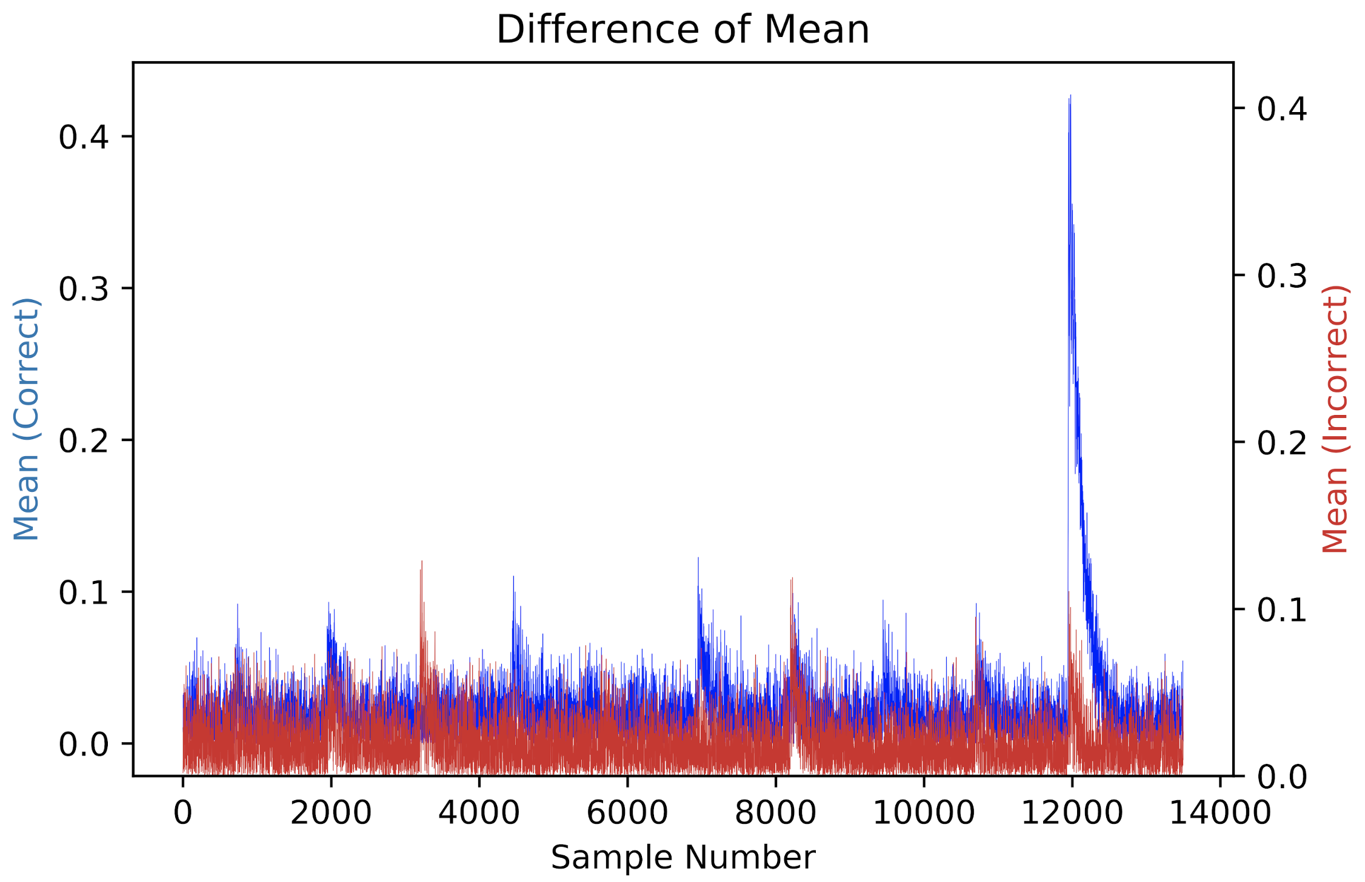
DOM Results Targeting Last Round (all keys)

Slide 30

Stefan Mangard, Elisabeth Oswald, Thomas Popp, Power Analysis Attacks: Revealing the Secrets of Smart Cards

Slide 31
Conclusion:
DPA set-up is crucial to the success of DPA
Noise is an integral component of power traces.
DPA is based on statistical theory:
Use of Hypothesis Testing can help in estimating number of observations required for estimating the parameters needed for an attack with high confidence.

Slide 32


